Slide 1

Crab and Lobster Stock Assessments
2016-2019
Carlos Mesquita
Marine Directorate
Aberdeen
carlos.mesquita@gov.scot
23/08/2023

Slide 2

Outline
Crab and Lobster Stock assessments (brown crab, velvet crab and lobster)
Assessment units
Landings
Sampling data
Stock assessments: Length Cohort Analysis (LCA) & LBIs
Survey indicators
Advice and ongoing work

Slide 3
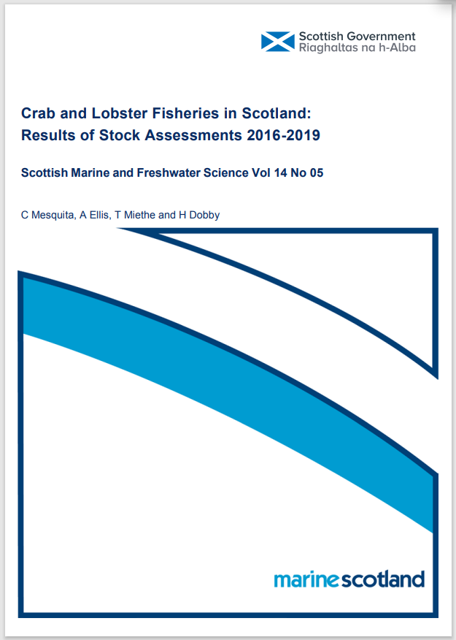
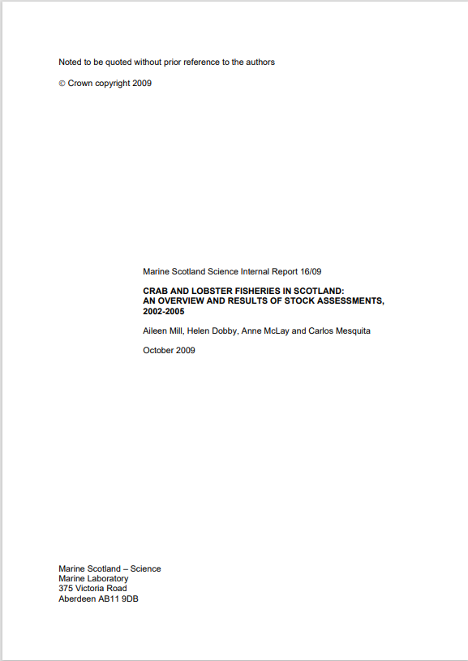
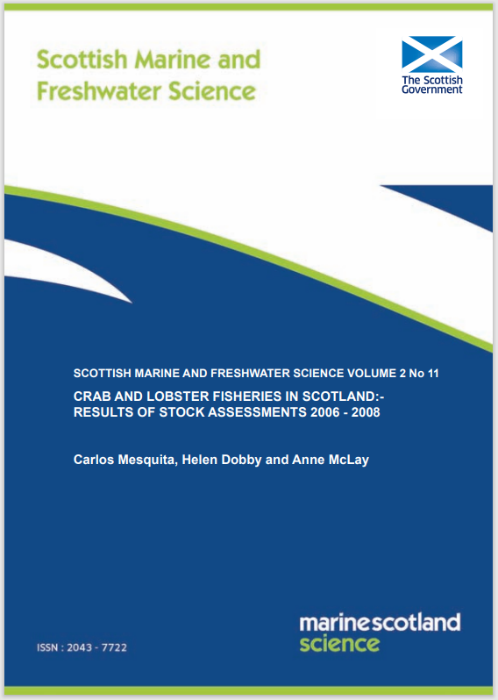
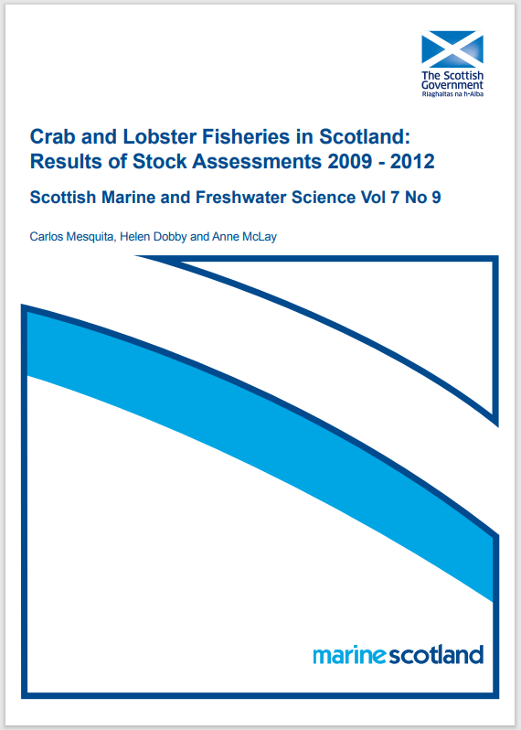

Crab and Lobster assessments (2016-2019)
Aiming to provide stock assessments every 3 years (brown crab, velvet crab, European lobster)
Previous assessments:
2002-2005
2006-2008
2009-2012
2013-2015
2016-2019

Slide 4
Crab and Lobster assessment units in Scotland
12 Management Units
Based on the landings reporting system

Slide 5
Brown crab - landings
Year | Landings (tonnes)
2012 | 10890
2013 | 10891
2014 | 12306
2015 | 11087
2016 | 12141
2017 | 11600
2018 | 10423
2019 | 9818
2020 | 6635
2021 | 6442

Slide 6
Velvet crab - landings
Year | Landings (tonnes)
2012 | 2032
2013 | 1576
2014 | 1641
2015 | 1494
2016 | 1613
2017 | 1597
2018 | 1181
2019 | 1565
2020 | 1563
2021 | 1612

Slide 7
Lobster- landings
Year | Landings (tonnes)
2012 | 1132
2013 | 1026
2014 | 1208
2015 | 1042
2016 | 1151
2017 | 1214
2018 | 1216
2019 | 1191
2020 | 1089
2021 | 1146

Slide 8
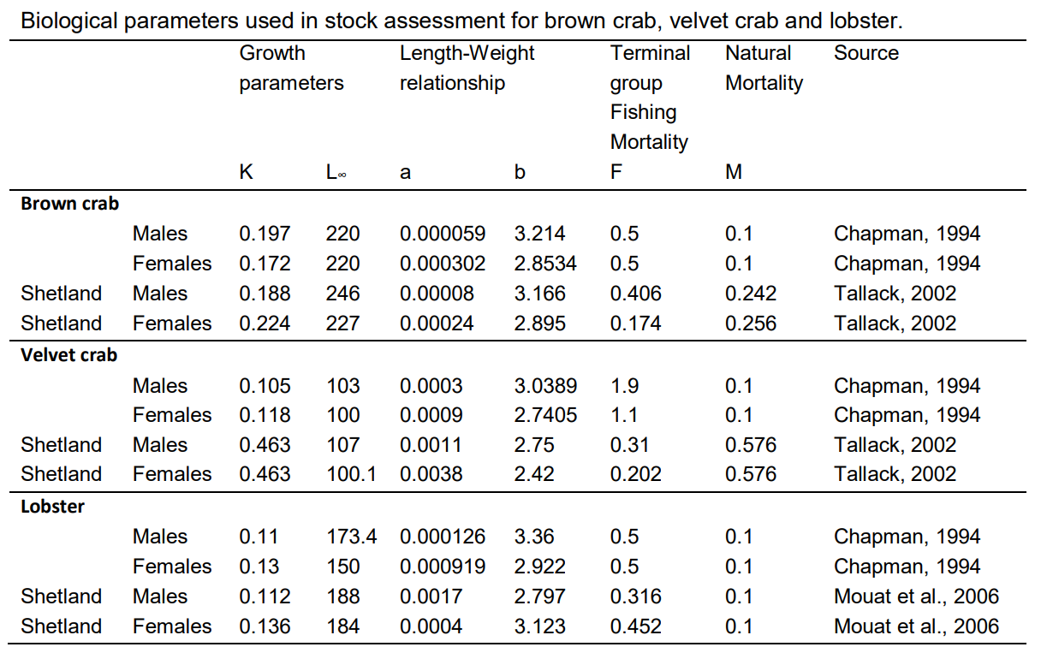
Assessment data sources
Official landings data
Scientific Sampling Programme (numbers at length)
Biological parameters

Slide 9
Sampling Data
Data collected in ports/shellfish processors
  Length Frequency data (Sampling Programme)
Size & sex composition
Discard data not collected regularly
  Some discard data available (2008/2010/2016)
Main reasons to discard
  Size (below MLS) – high survival
  White/soft individuals
  Crippled/damaged animals
No directed survey data – scallop/trawl surveys indicators for brown crab

Slide 10
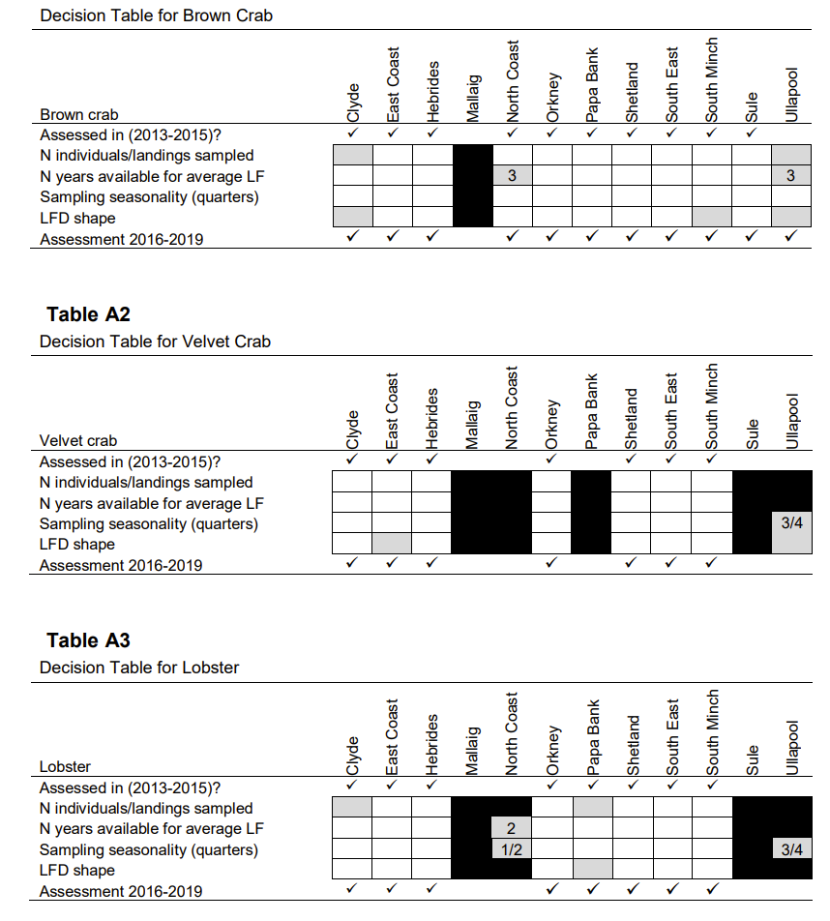
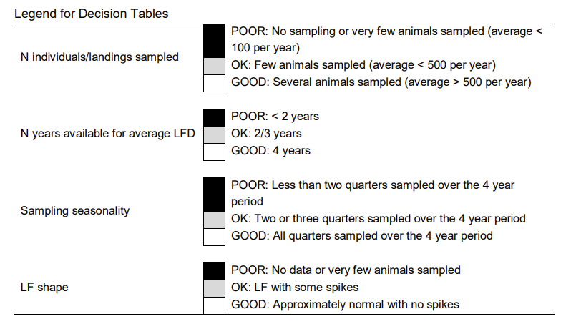
Sampling Data

Slide 11
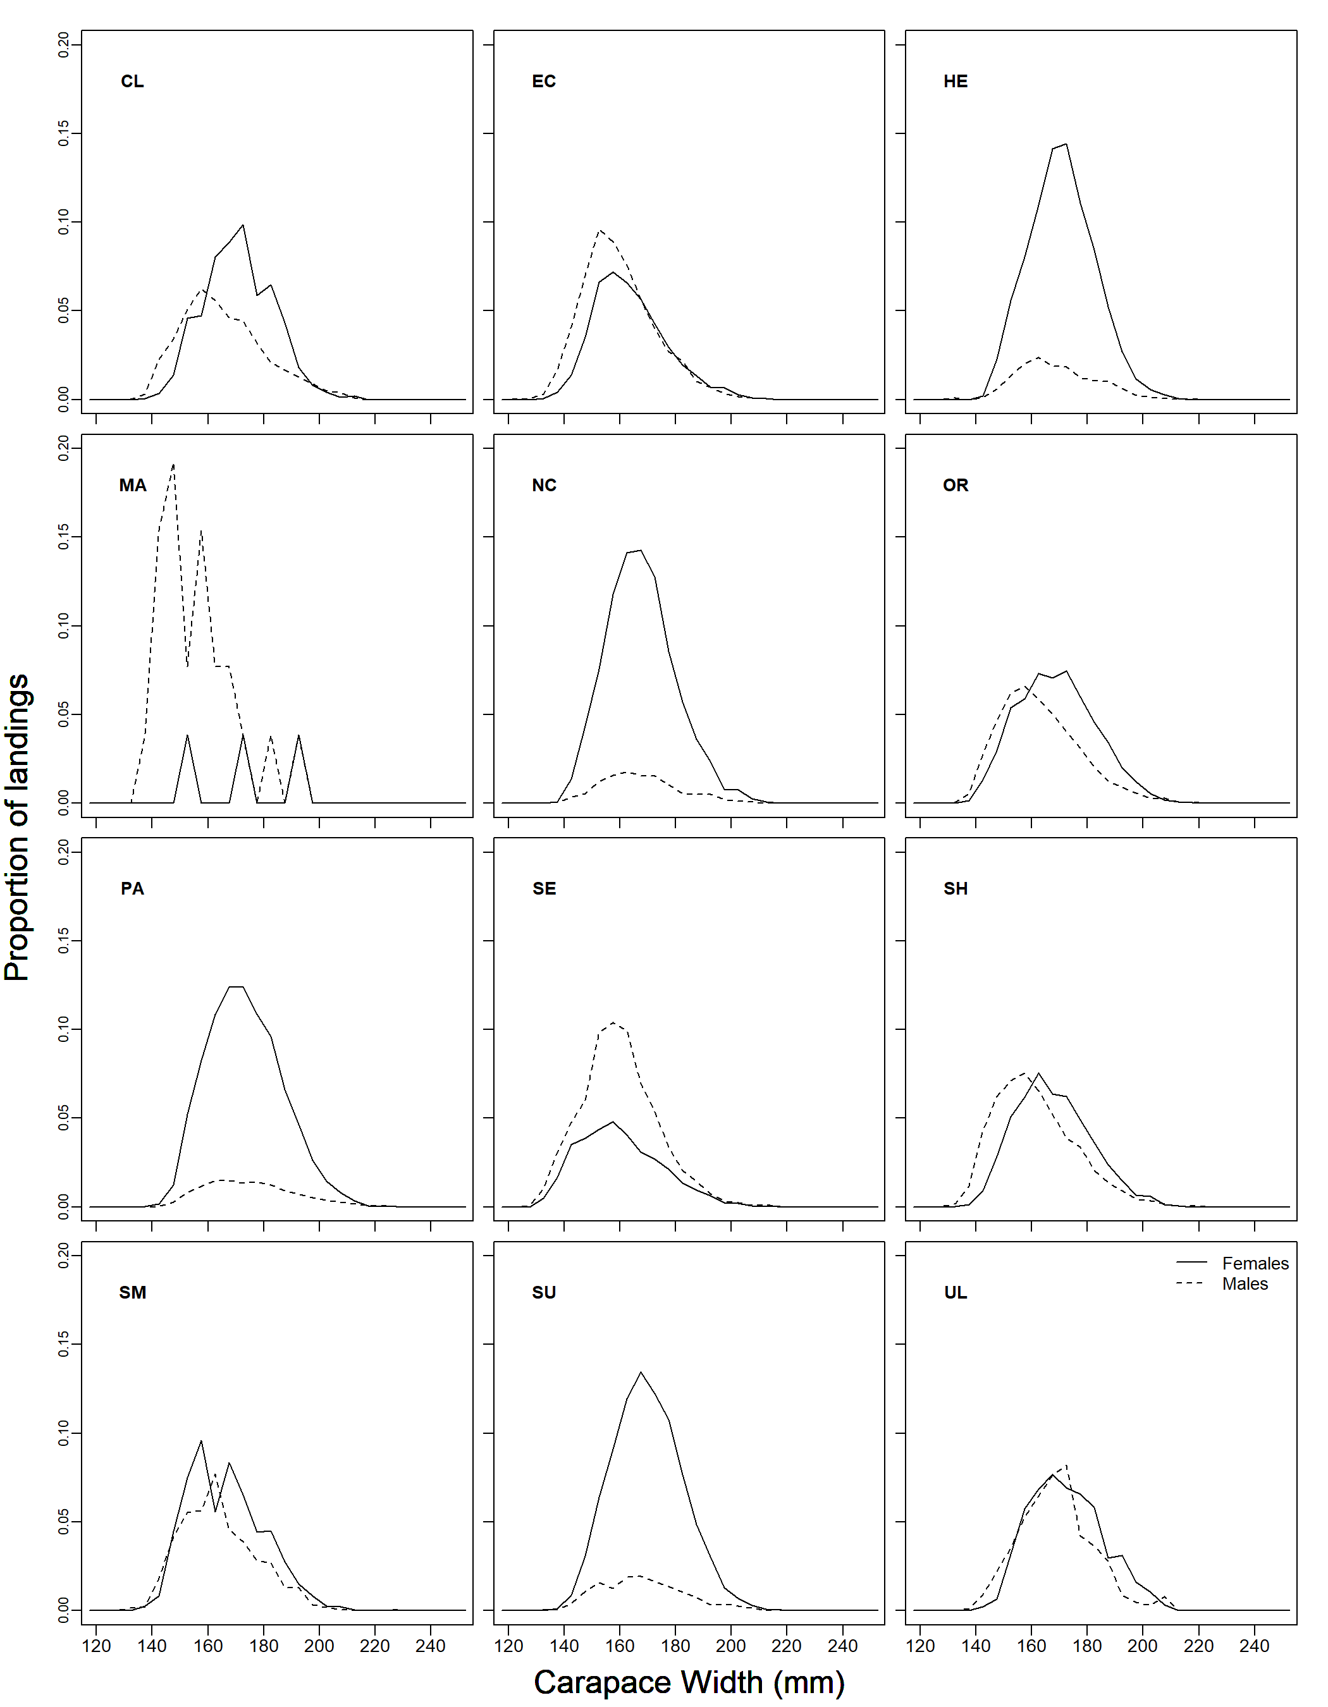
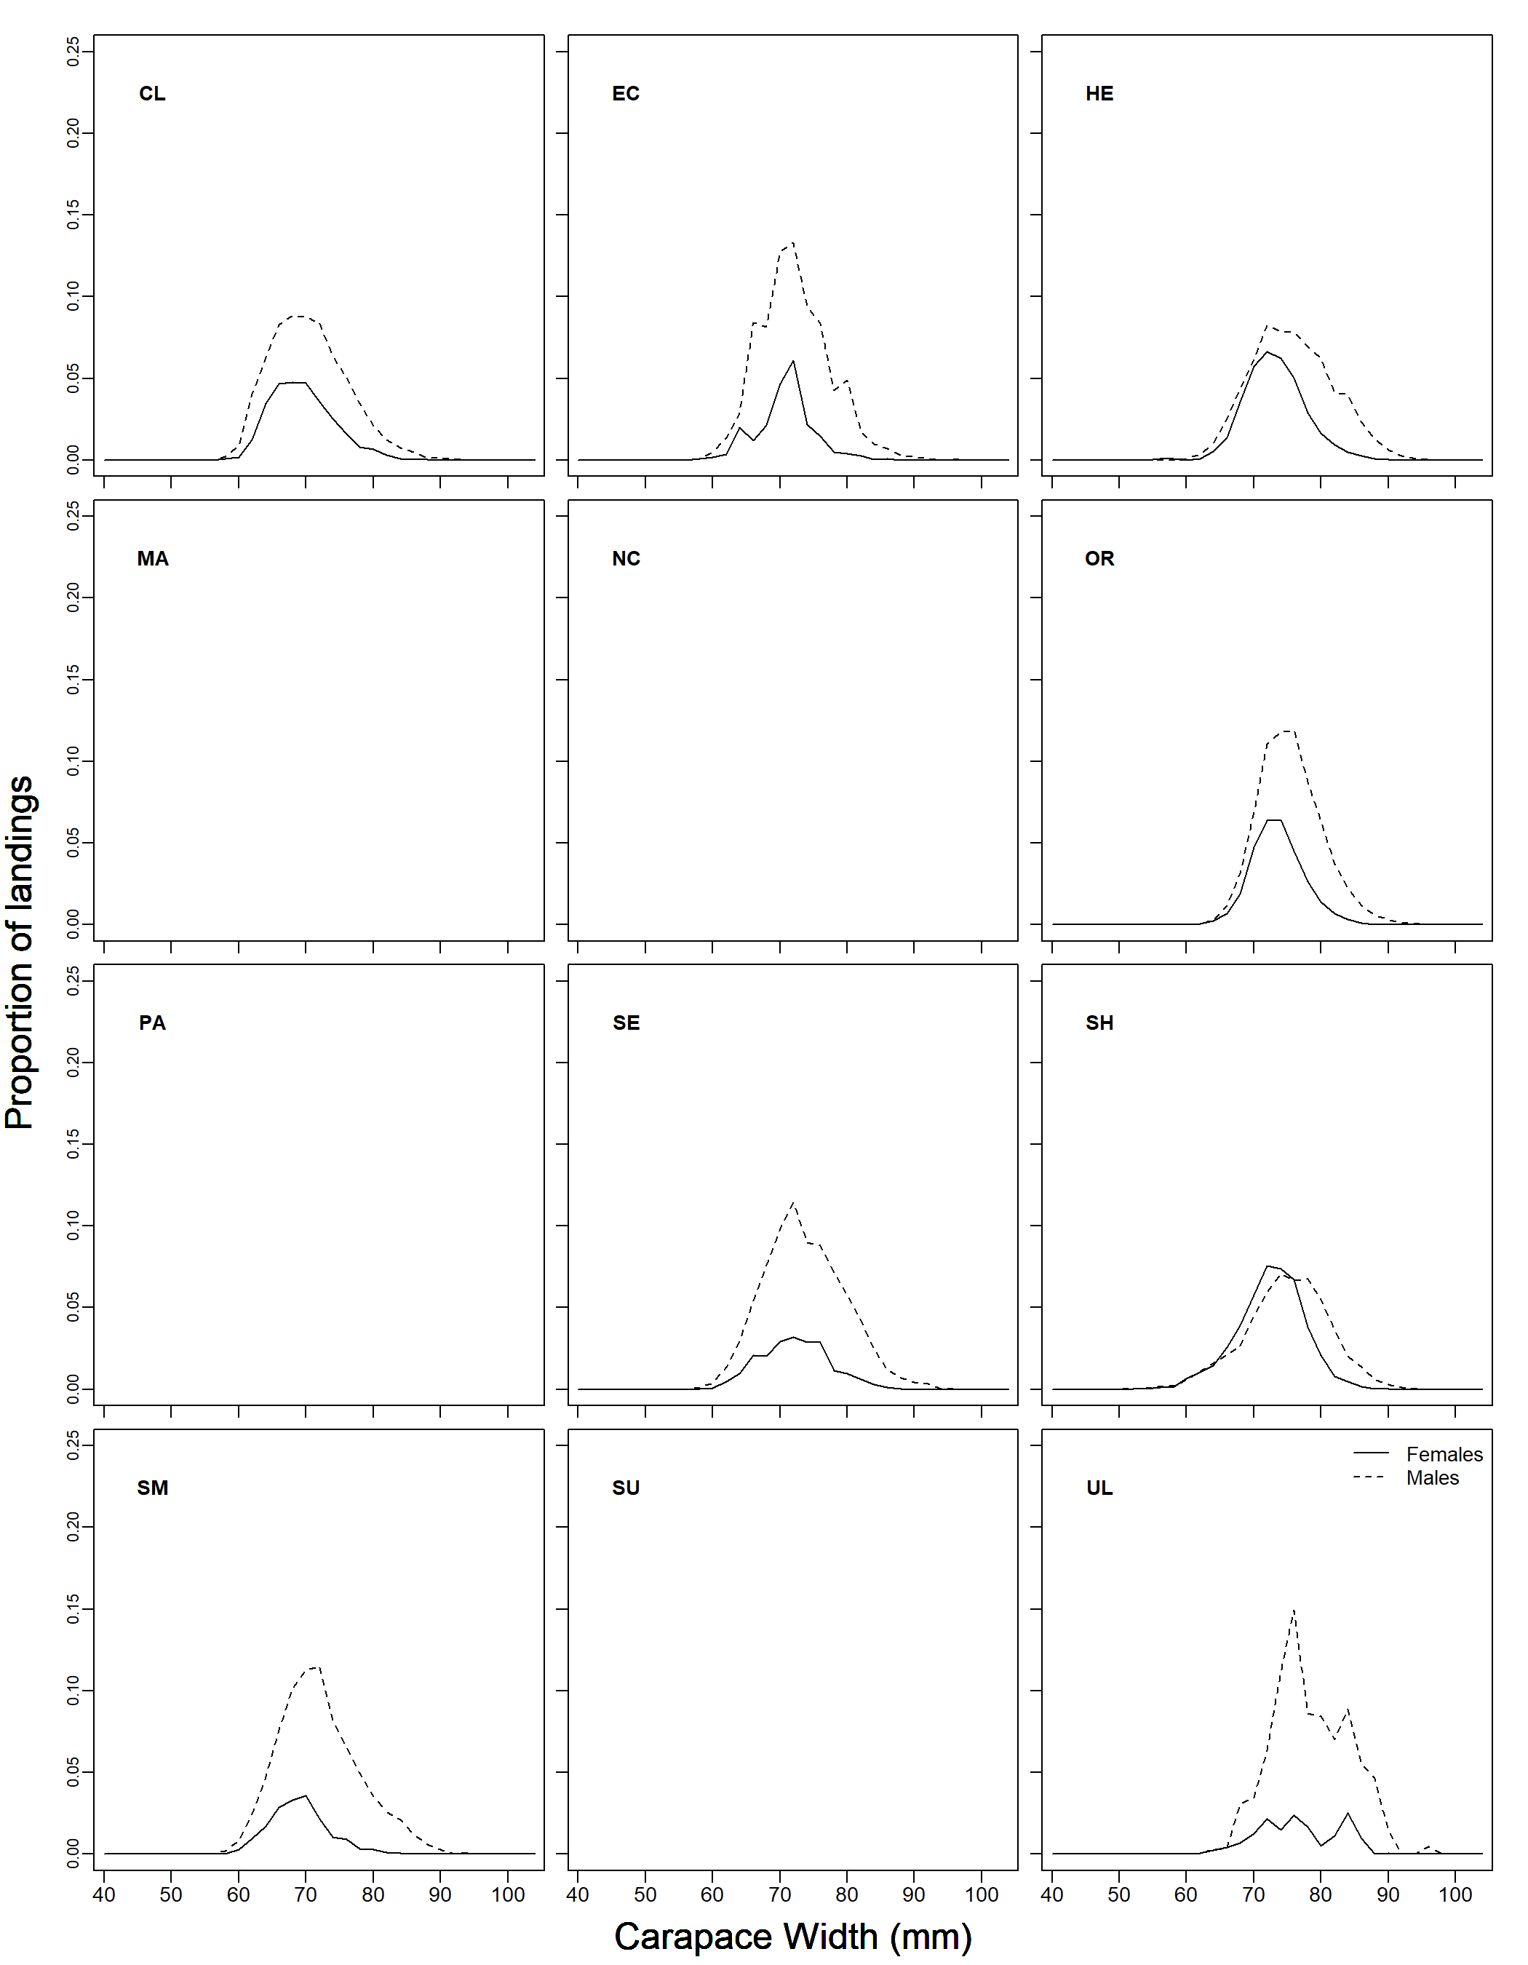
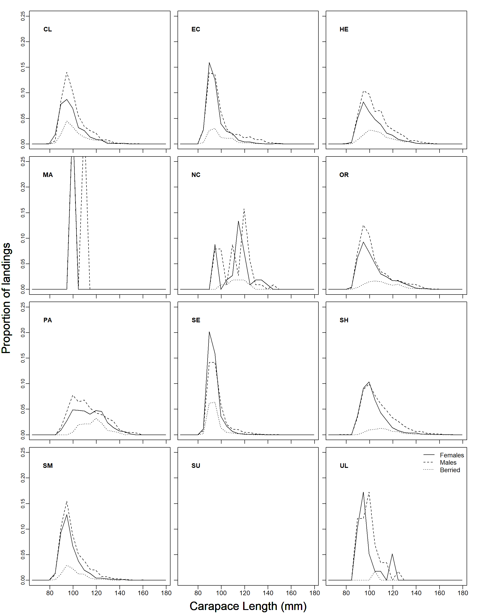
Sampling Data – length frequencies
Brown crab
Velvet crab
Lobster

Slide 12
Length Cohort Analysis (LCA) (Jones, 1984)
Age determination is difficult in crustacean species
LCA based on commercial catch size composition is used
Estimates of fishing mortality (F) at length and stock biomass
Assumptions:
  Length distribution is representative (averaged over a number of years)
  Population is in equilibrium
  Uniform growth among animals
  No major changes in fishery

Slide 13
Length Cohort Analysis
Low F
Catch
High F
Consider how length distribution changes with Fishing mortality (F)
length

Slide 14
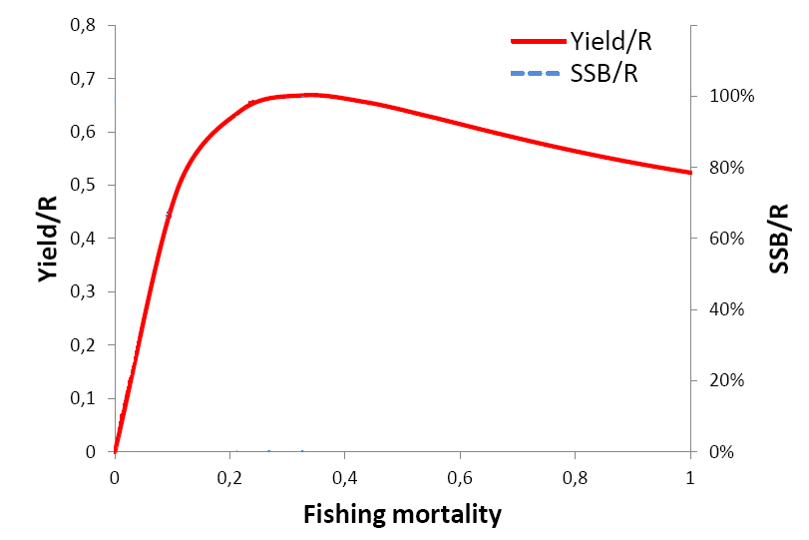
Length Cohort Analysis - Yield-per-Recruit (YPR)
LCA results are presented in terms of Yield-per-Recruit
Framework for evaluation of management measures
30%
F_{0.1}
F_{max}
F_{30%SPR}

Slide 15
Length Cohort Analysis - Yield-per-Recruit (YPR)
F_{MSY} proxies
Stock-recruitment relationship unknown: constant recruitment model
Requires estimates of biological parameters & fishery selection
F_{MAX} used as a proxy for F_{MSY}
30%
F_{0.1}
F_{max}
F_{30%SPR}

Slide 16
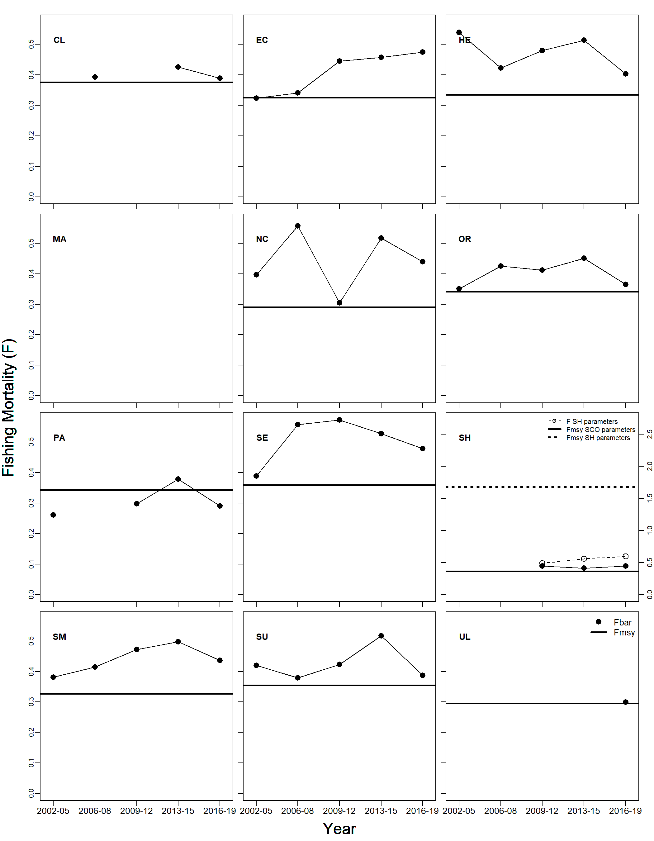
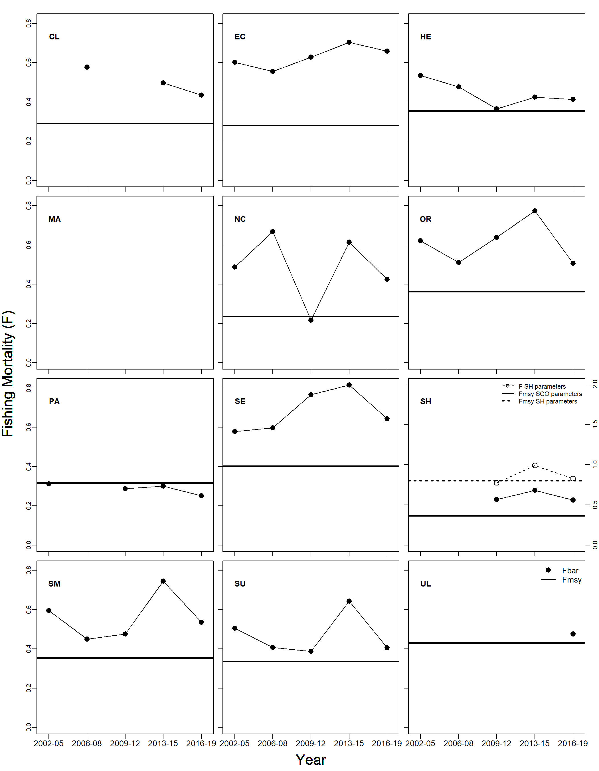
LCA results – Brown crab Fishing Mortality (F)
Females
Males

Slide 17
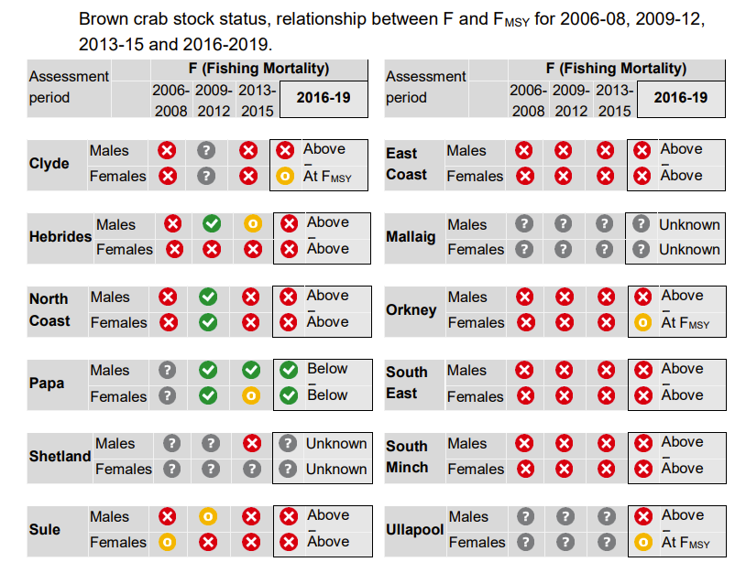
LCA results – Brown crab

Slide 18
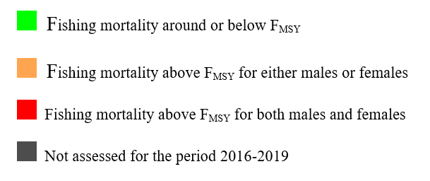
LCA results – Brown crab

Slide 19
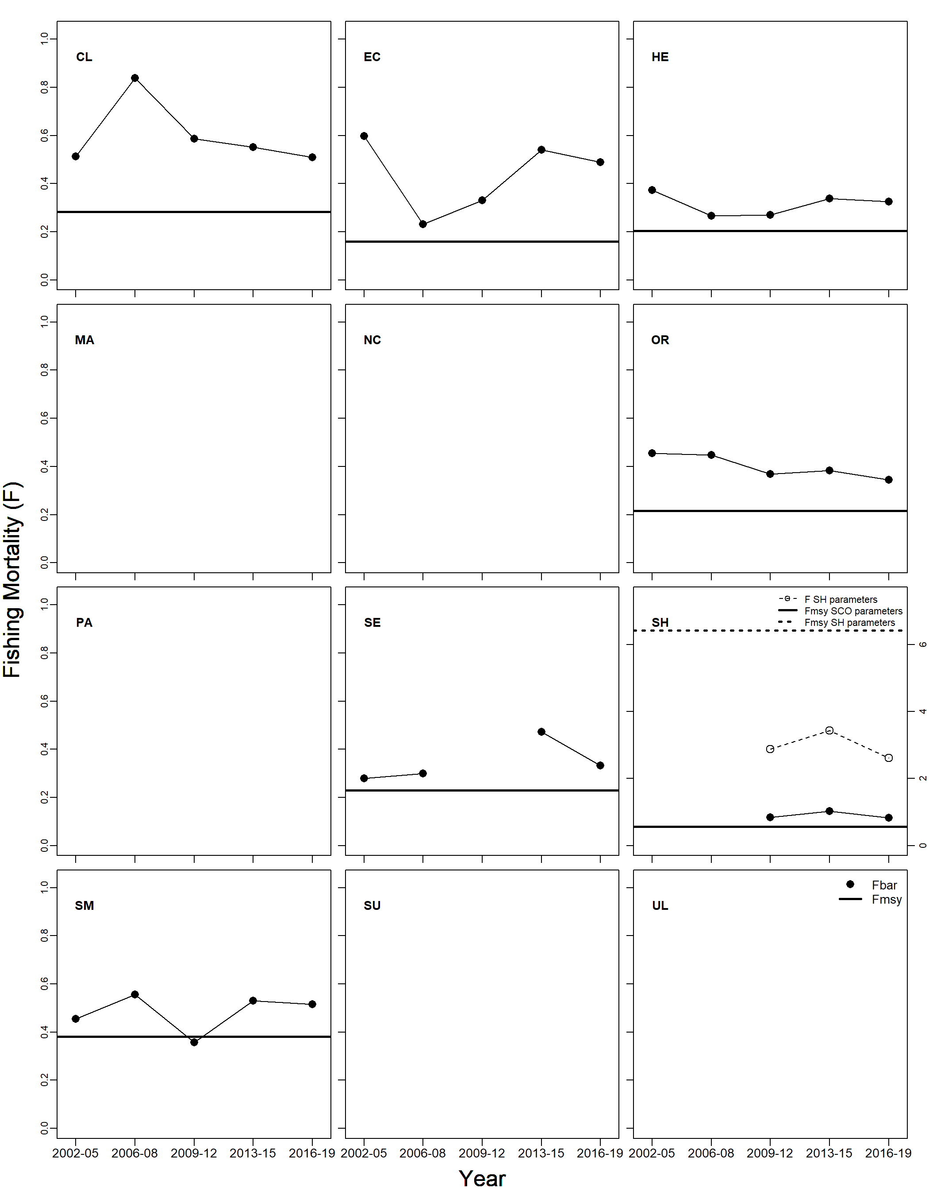
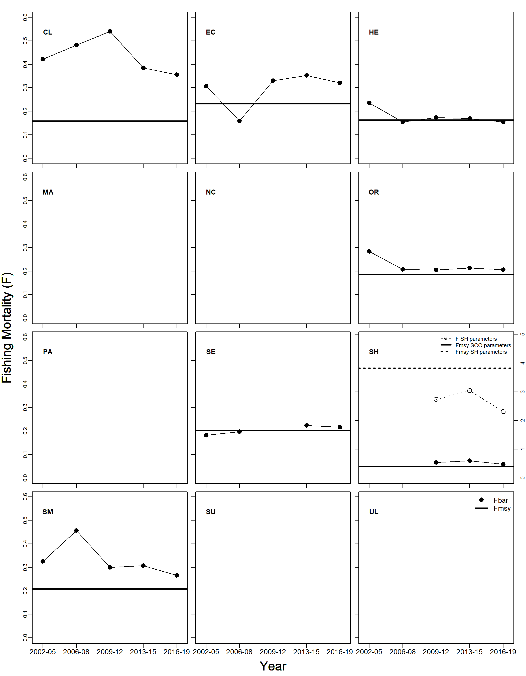
LCA results – Velvet crab Fishing Mortality (F)
Females
Males

Slide 20
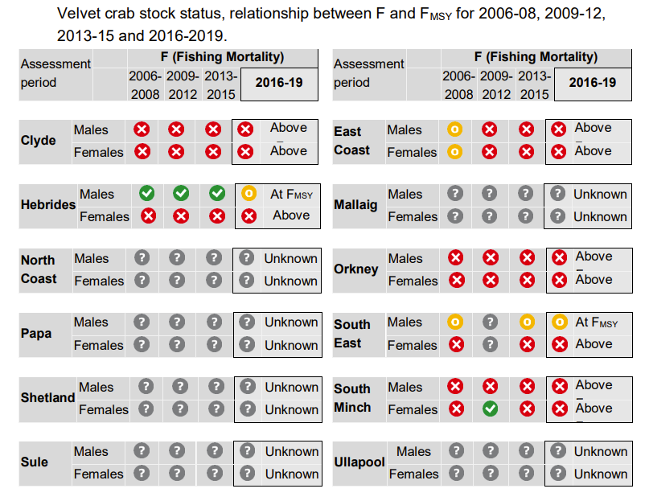
LCA results – Velvet crab

Slide 21
LCA results – Velvet crab

Slide 22
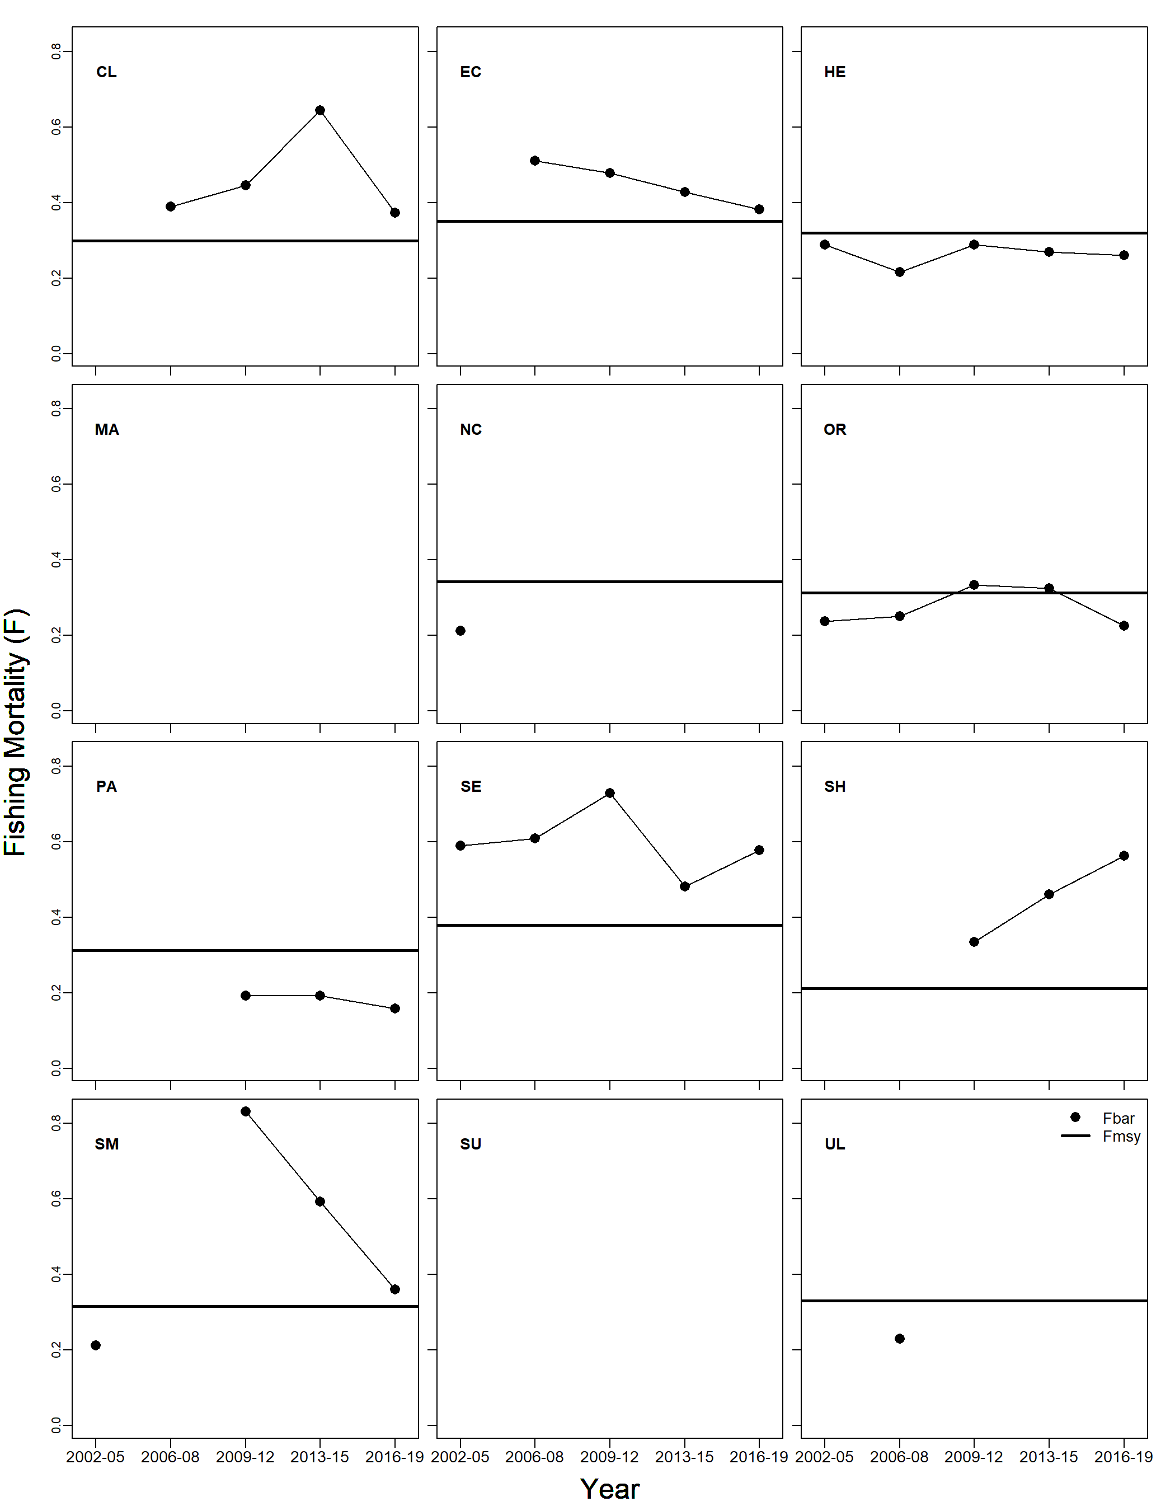
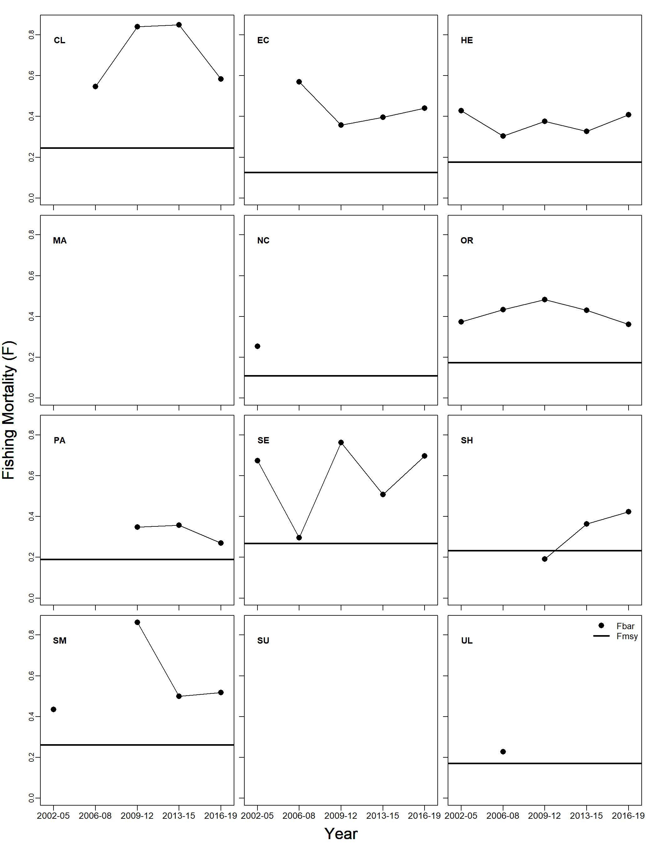
LCA results – Lobster Fishing Mortality (F)
Females
Males

Slide 23
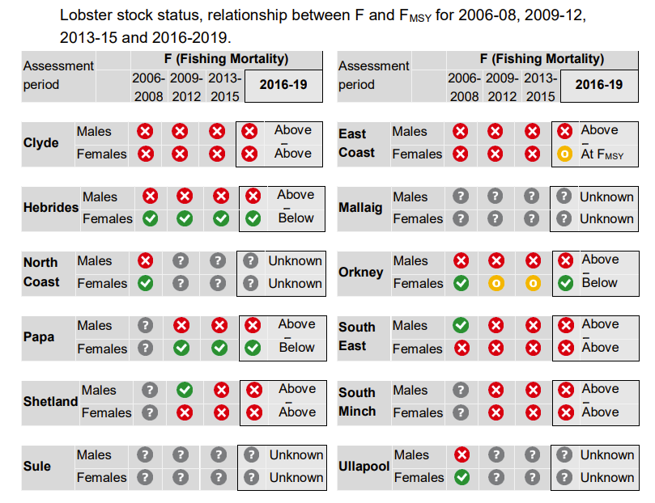
LCA results – Lobster

Slide 24
LCA results – Lobster

Slide 25
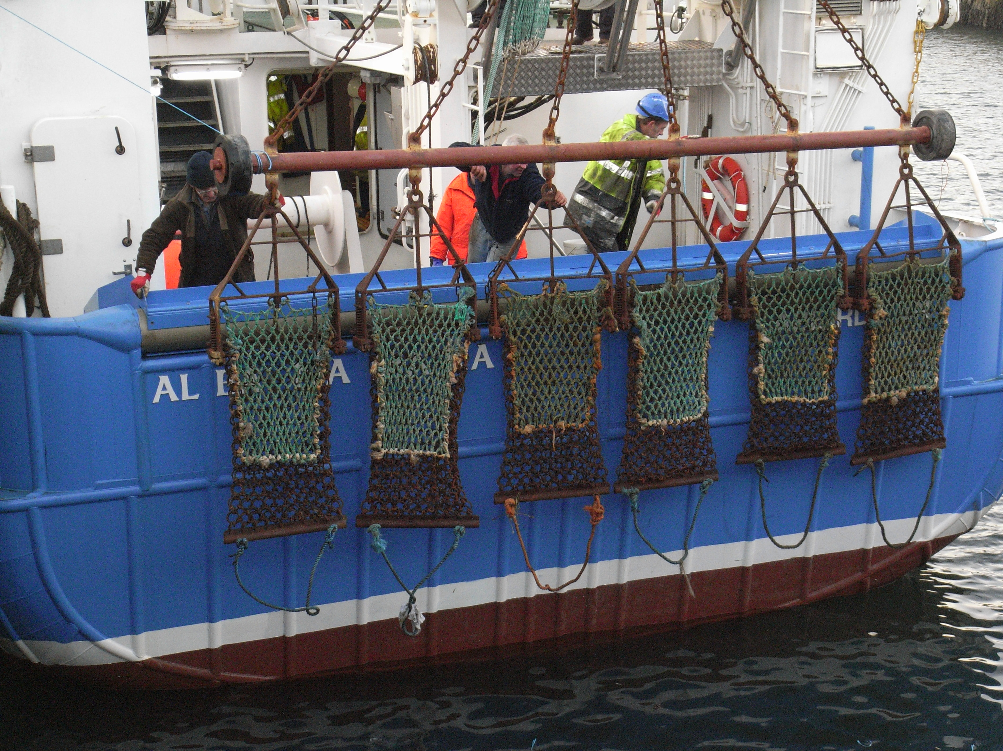
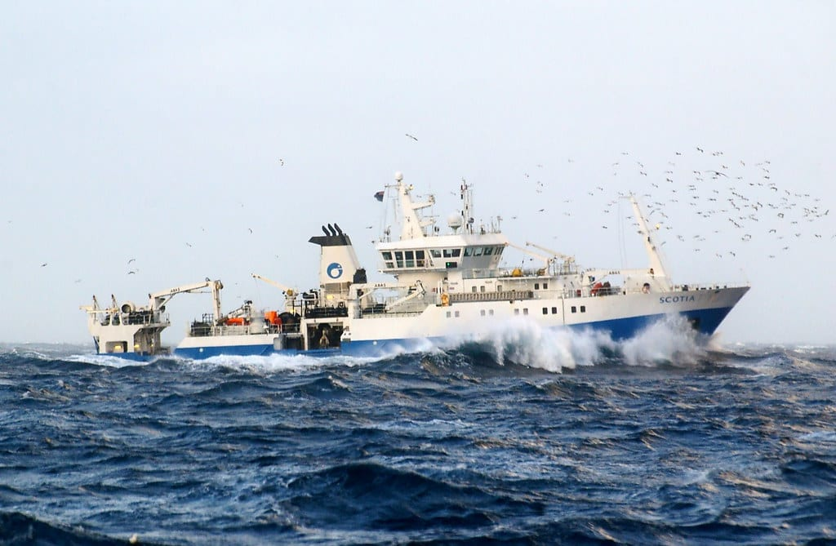
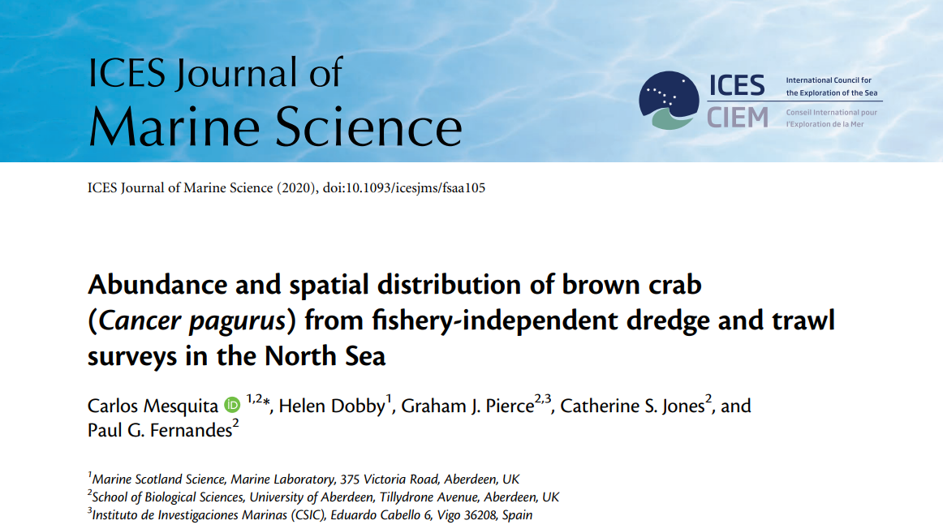
Survey indices – Brown crab
Scallop Dredge Surveys
Trawl Surveys - IBTS
Survey indices paper
Swept area calculated: tow length ×gear width
Response variable: crab catch rate (N/m²)

Slide 26
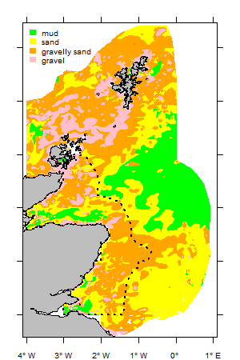
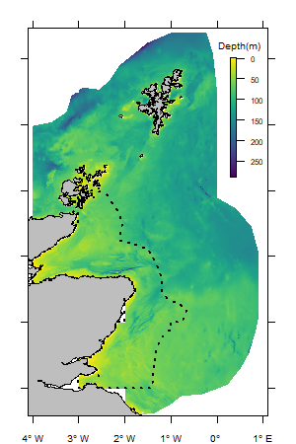
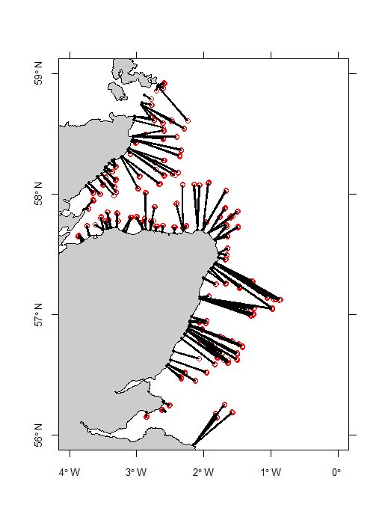
Survey indices - Variables of interest
Sediment type
(BGS)
Distance
to coast
Depth

Slide 27
Survey indices – Brown crab
Shetland
West Coast
East Coast

Slide 28
Survey indices – Abundance
East Coast
Shetland
West Coast

Slide 29
Crab and lobster - Advice
Most stocks fished close to or above F_{MSY}
Recommendation for reduction in fishing mortality (stocks fished above F_{MSY})
Growth overfishing vs. recruitment overfishing
Combine stock assessment techniques with other length-based indicators (LBI)
LBI mostly in agreement with LCA
Best to interpret LCA with other information such LPUE

Slide 30
Crab and lobster - Advice
Can advise for % decrease (increase) in F to reach F_{MSY} proxy
Translate to effort – assuming direct relationship F & effort.
What measure of effort? How many creels?
Translation to catches require knowledge of abundance (trends)
Survey trends available for brown crab (not at the stock level)
Additional information, e.g. factors affecting catchability - engaging with fishers and industry.

Slide 31
Ongoing work
VMS allows detailed mapping of fishing activity - potential to estimate fishing effort/LPUE
Size-at-maturity work
Survey analysis (scallop by-catch and IBTS) – spatial distribution of brown crab
Discard data analysis – some brown crab observer trips available
Stock Assessments: LCA (2016-2019), other methods?

Slide 32
Crab and Lobster Stock Assessments
2016-2019
Thank you

